Slide 1
Microsoft Power BI

Slide 2
Setting Datasource Credentials with the Power BI REST API
Ted Pattison
Principal Program Manager
Power BI Customer Advisory Team (PBICAT)

Slide 3
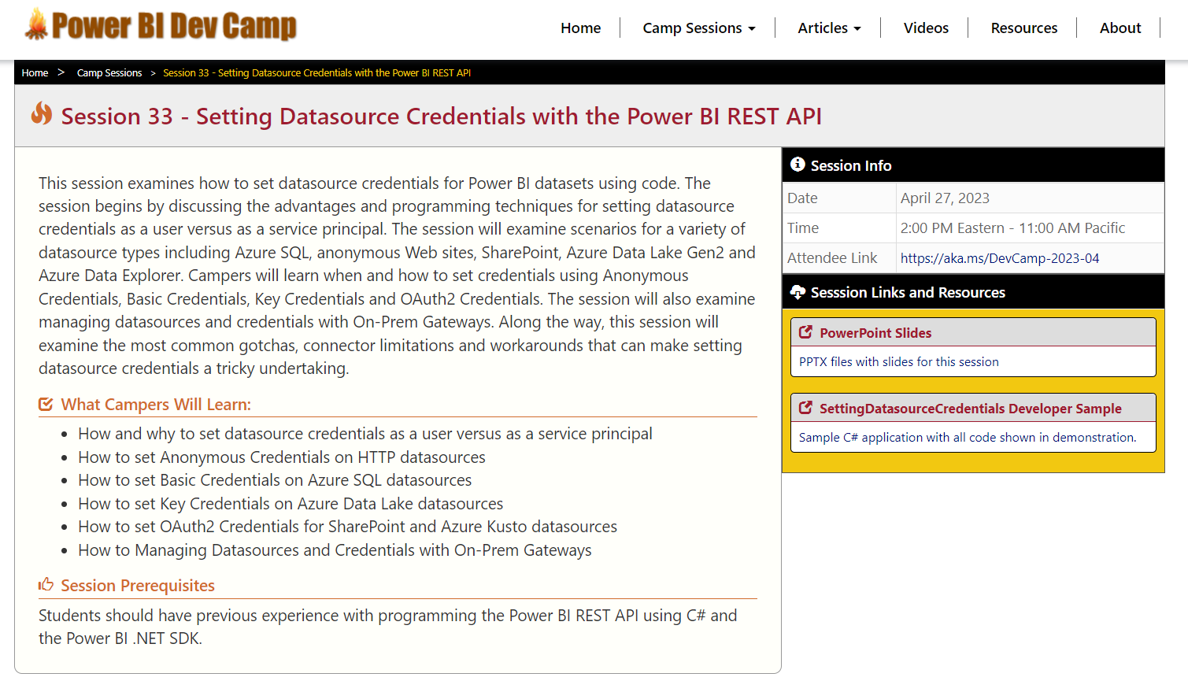
Welcome to Power BI Dev Camp
Check out the Power BI Dev Camp Portal at https://powerbidevcamp.net

Slide 4
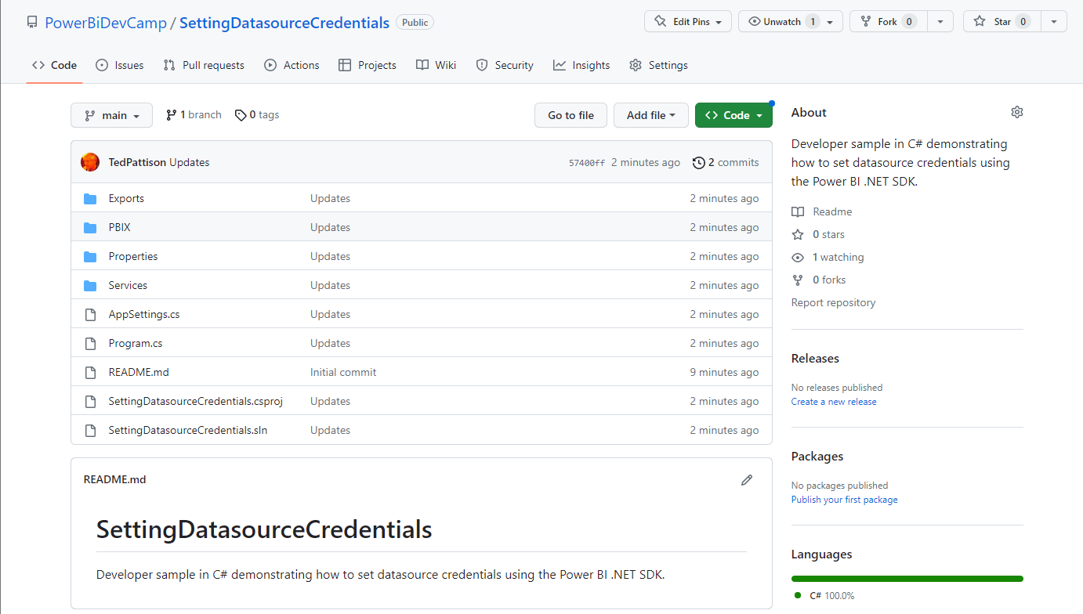
GitHub Repository with Developer Sample
All source code and documentation available through public GitHub repository
https://github.com/PowerBiDevCamp/SettingDatasourceCredentials

Slide 5
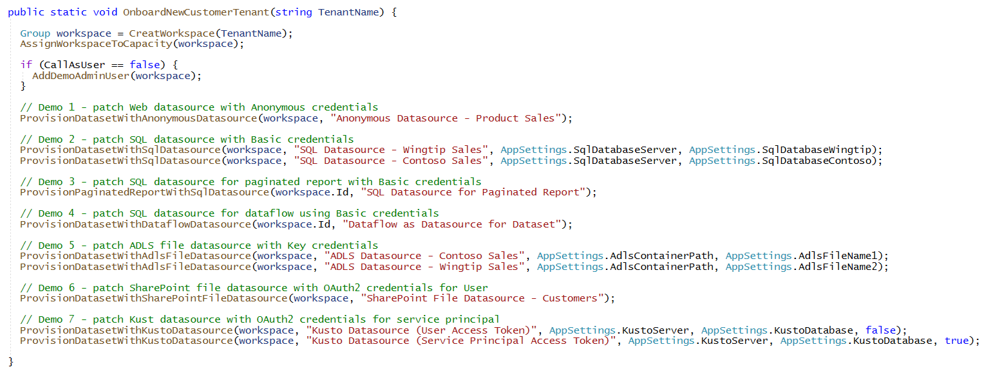
Demos Ahead In This Session
Demo 1 - Patch Web datasource with Anonymous credentials
Demo 2 - Patch SQL datasource with Basic credentials
Demo 3 - Patch SQL datasource for paginated report with Basic credentials
Demo 4 - Patch SQL datasource for dataflow using Basic credentials
Demo 5 - Patch ADLS file datasource with Key credentials
Demo 6 - Patch SharePoint file datasource with OAuth2 credentials for User
Demo 7 - Patch Kusto datasource with OAuth2 credentials for User and for service principal

Slide 6
Agenda
AuthN and AuthZ with the Power BI REST API
Provisioning Workspaces and Datasets
Patching SQL Datasources using Basic Credentials
Patching ADLS Datasource using Key Credentials
Patching SharePoint and Kusto Datasource using OAuth2 Credentials
Managing Datasources and Credentials with On-Prem Gateways

Slide 7
Working with the Power BI REST API
You can call Power BI REST API several different ways
Call Power BI REST API as user
Call Power BI REST API as service principal (or service principal profile)
Calling the Power BI REST API as a user
Create Azure AD application to support user authentication
Acquiring access tokens for user often requires user interaction
Access tokens acquired for users must contain delegated permissions
Calling the Power BI REST API as a service principal
Create Azure AD application to support service principal authentication
Access tokens acquired for service principal do not contain delegated permissions

Slide 8
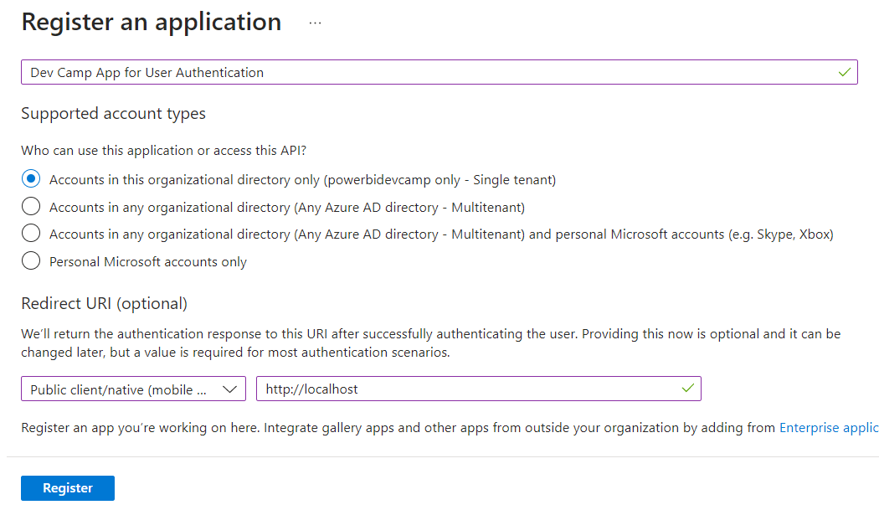
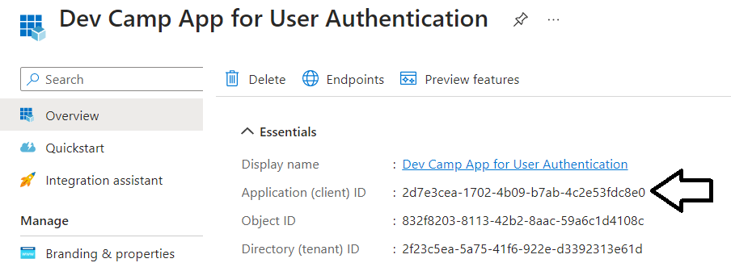
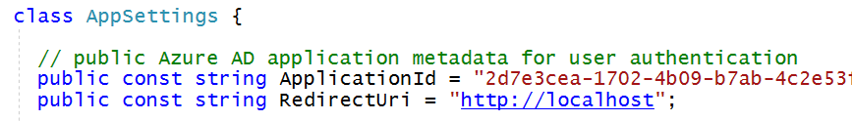
Azure AD Application for User Authentication
Creating a Public Application in Azure AD for User Authentication
Choose Public client/native from dropdown menu
Add a Redirect URI of http://localhost
There is no need to register any delegated permissions – that is handled by the C# application
After creating Azure AD application, copy the Application ID into AppSettings.cs

Slide 9
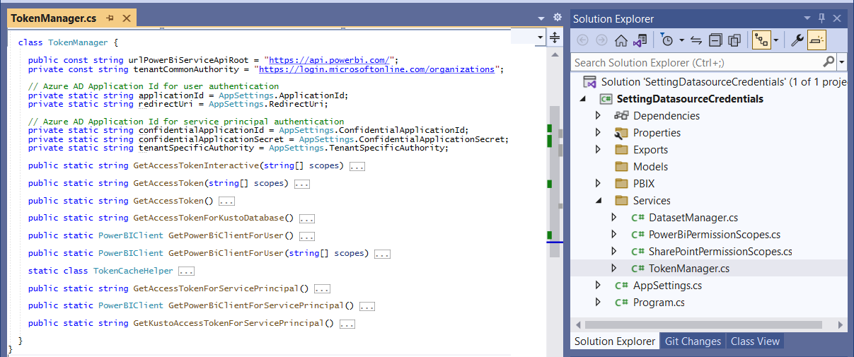
TokenManager class implements authentication flows
TokenManager class handles all authentication and token acquisition

Slide 10
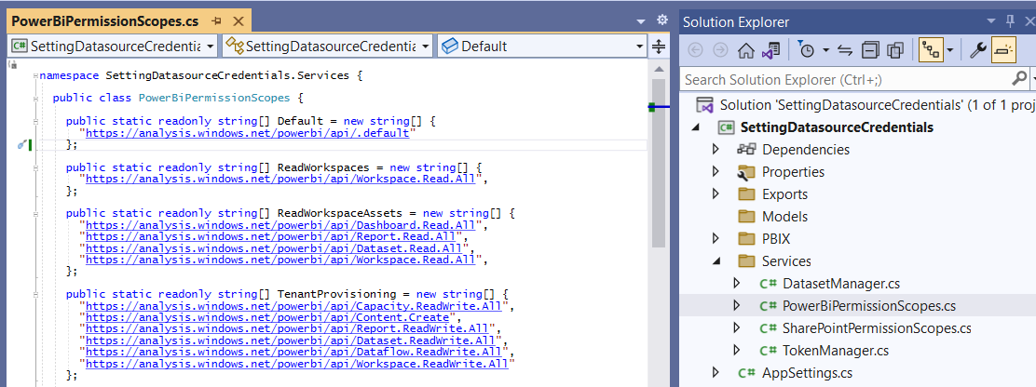
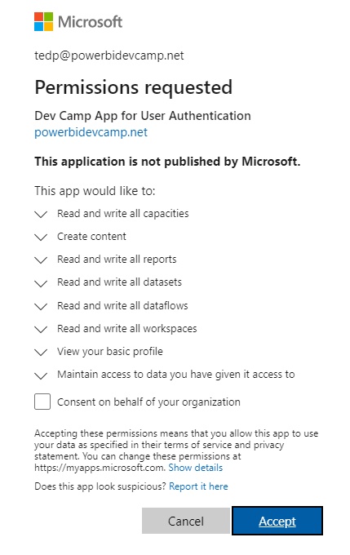
Delegated Permission Scopes for User Access
Delegated permissions required when calling API with user identity
Delegated permissions must be added to access token when calling PBI REST API as a user
The application passes requested delegated permission list in call to acquire access token
During first authentication, Azure AD prompts user to approve permission request
After first authentication request, Azure AD remembers that the user has approved request

Slide 11
Calling the Power BI REST API as Service Principal
Calling API as service principal has advantages over calling API as user
Service principal authentication never requires interaction – better for automated scenarios
Removes dependencies on Azure AD user accounts
Eliminates impact as users come and go from organization
Calling API as service principal has disadvantages over calling API as user
Unable to view or change dataset properties in Power BI Service UI
Unable to set notification recipient when configuring scheduled refresh
Unable to create dataflows using Imports API

Slide 12
Access Control for Service Principals
API access control for service principals is very different than for users
Service principal access control not based on Azure AD permissions
Access for service principals must be explicitly enabled for Power BI tenant
Once enabled, service principal has no default access to any workspaces
Service principal must be added as workspace member to access workspace
Service principal creating workspace automatically added as workspace Admin

Slide 13
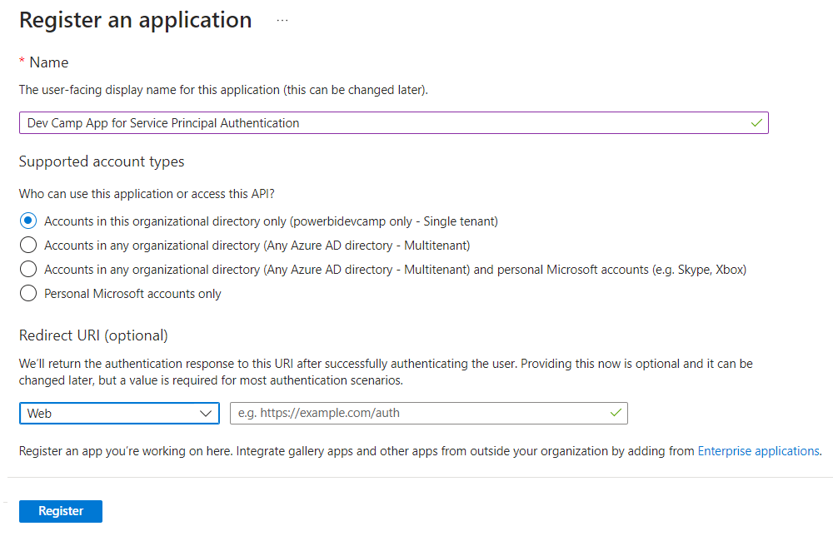
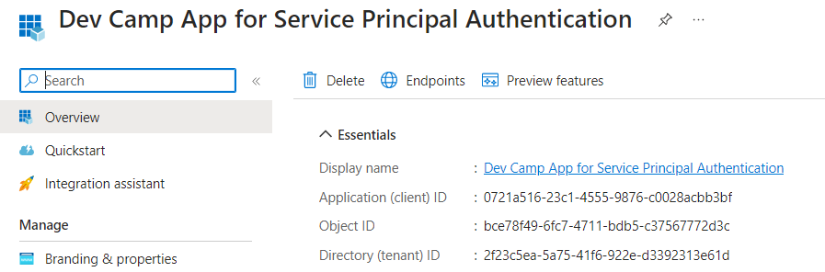
Azure AD Application for Service Principal Authentication
Creating a Confidential Application in Azure AD for a service principal
Choose Web from dropdown menu – this is what makes it a confidential application
Leave Redirect URL textbox empty – Redirect URLs only used for user authentication
Copy the Application ID and Tenant ID so you can paste it into AppSettings.cs.
The next step in configuring this Azure AD application is to create an application secret

Slide 14
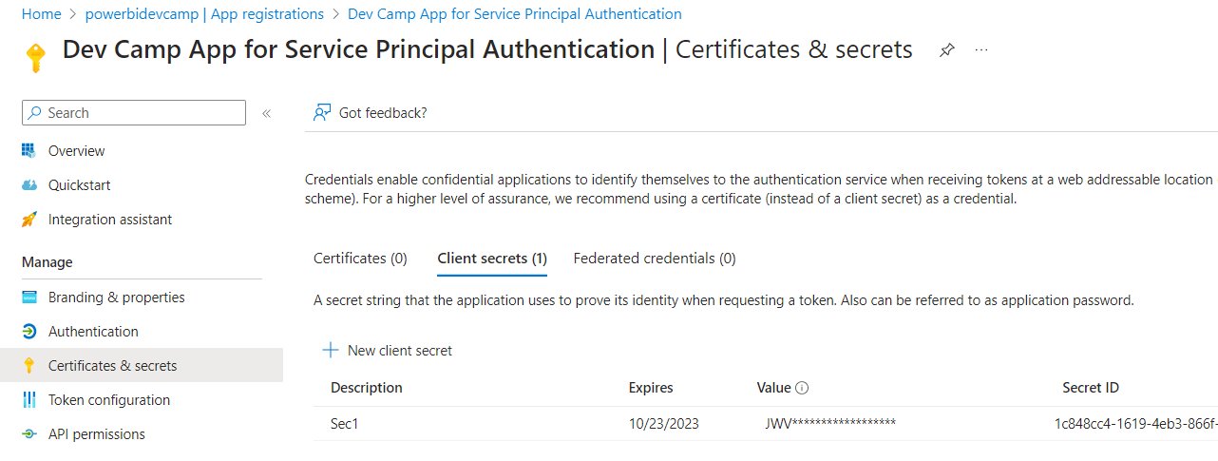
Creating App Secret for Service Principal Authentication
Creating a new application secret (aka client)
Navigate to Certificates and secrets
Create a new application secret by clicking New client secret link
After application secret has been created, copy its value and paste it into AppSettings.cs

Slide 15
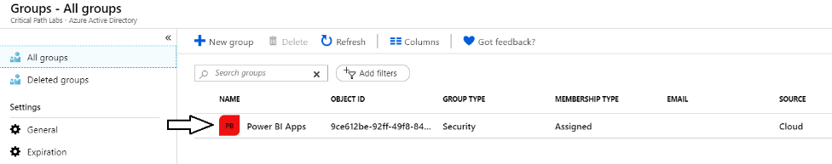
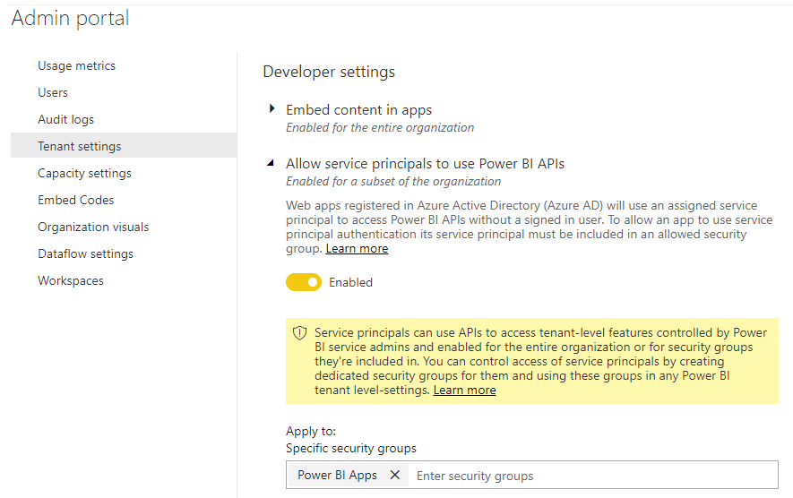
Configuring Service Principal Access in Power BI Tenant
Service Principal Access Must Be Explicitly Enabled in Power BI Admin Portal
Create an Azure AD security group (e.g. Power BI Apps)
Add group to Power BI Allow service principals to use Power BI APIs in PBI Admin portal

Slide 16
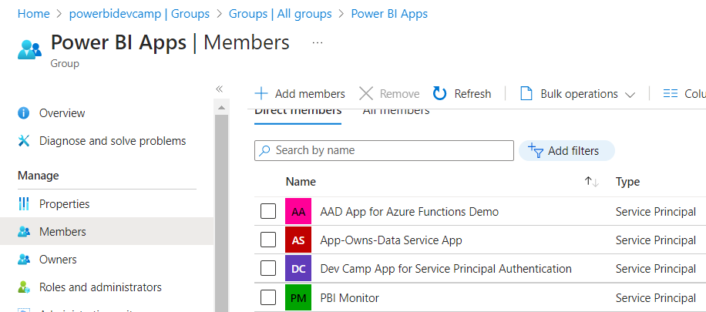
Adding Azure AD Application to Power BI Apps Group
This is what gives service principal permissions to call Power BI REST API
Remember this configuration step does not grant service principal access to any workspaces
Service principal must be added to workspaces as member
If service principal creates a workspace, it is automatically assigned as Admin member

Slide 17
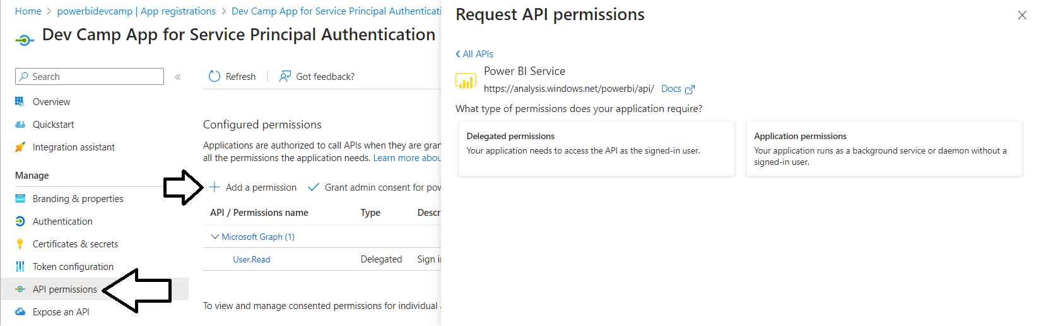

Great Misperception with Service Principal Authentiction
There’s no need to assign any permissions to Azure AD application
Any Delegated permissions you add are ignored - they only apply to users
Application permissions are not used in any way for access control to the Power BI REST API
Adding Application permissions will never help you – but it can hurt you

Slide 18
What Role Is Service Principal Playing in This Scenario
There are two different identities involved in this scenario
The caller that is patching credentials with the Power BI Service API
The identity that is used to establish connection to the datasource
Key Takeaways
The built-in Power BI connectors do not support connecting as service principal
Connecting to datasource as service principal requires building a custom connector
Service
Principal
Datasource Credentials
Call to Gateways – UpdateDatasource
this API call executes as service principal
Datasource Connection
Datasource
Connection to datasource
connection does not use service principal

Slide 19
Agenda
AuthN and AuthZ with the Power BI REST API
Provisioning Workspaces and Datasets
Patching SQL Datasources using Basic Credentials
Patching ADLS Datasources using Key Credentials
Patching SharePoint and Kusto Datasources using OAuth2 Credentials
Managing Datasources and Credentials with On-Prem Gateways

Slide 20

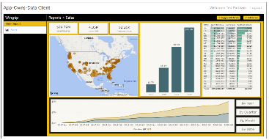
Provisioning Workspaces and Datasets
Power BI Multi-tenant Environment
Customer 01
17 users
Customer 01 Tenant
Sales
Power BI Workspace
Power BI Dataset
Datasource credentials
Power BI Report
Customer 02
243 users
Customer 02 Tenant
Sales
Power BI Workspace
Power BI Dataset
Datasource credentials
Power BI Report
Customer N
74 users
Customer N Tenant
Sales
Power BI Workspace
Power BI Dataset
Datasource credentials
Power BI Report

Slide 21
Typical Provisioning Scenario
Provisioning a Power BI workspace
Create workspace
Assign to Capacity
Add workspace members
Provisioning a Power BI dataset
Import dataset from PBIX file with dataset template
Update dataset parameters to point to datasource
Patch credentials for datasource connection
Start refresh operation (import mode only)
Set refresh schedule (import mode only)

Slide 22
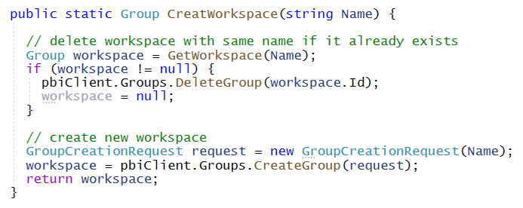
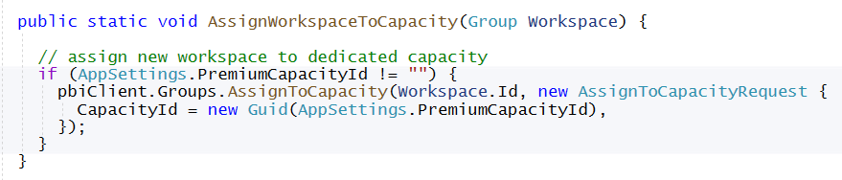
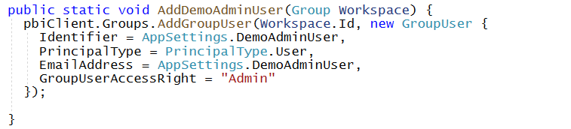
Provisioning Workspaces using the Power BI .NET SDK

Slide 23
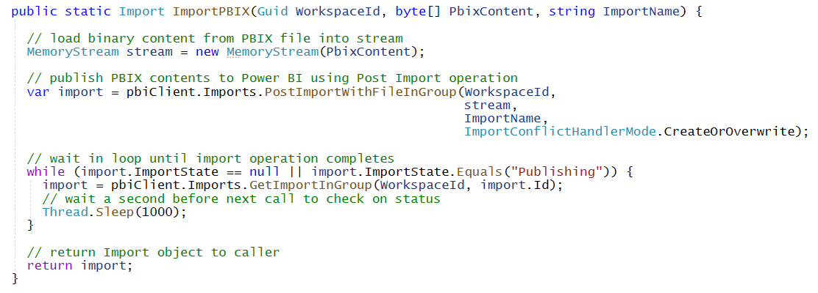
Importing PBIX Files
Steps to Importing PBIX file
Import PBIX file by calling Imports.PostImportWithFileInGroup
Use conflict handler of CreateOrOverwrite to overwrite previous import of the same name
Call GetImportInGroup in loop to determine when import operation has completed

Slide 24
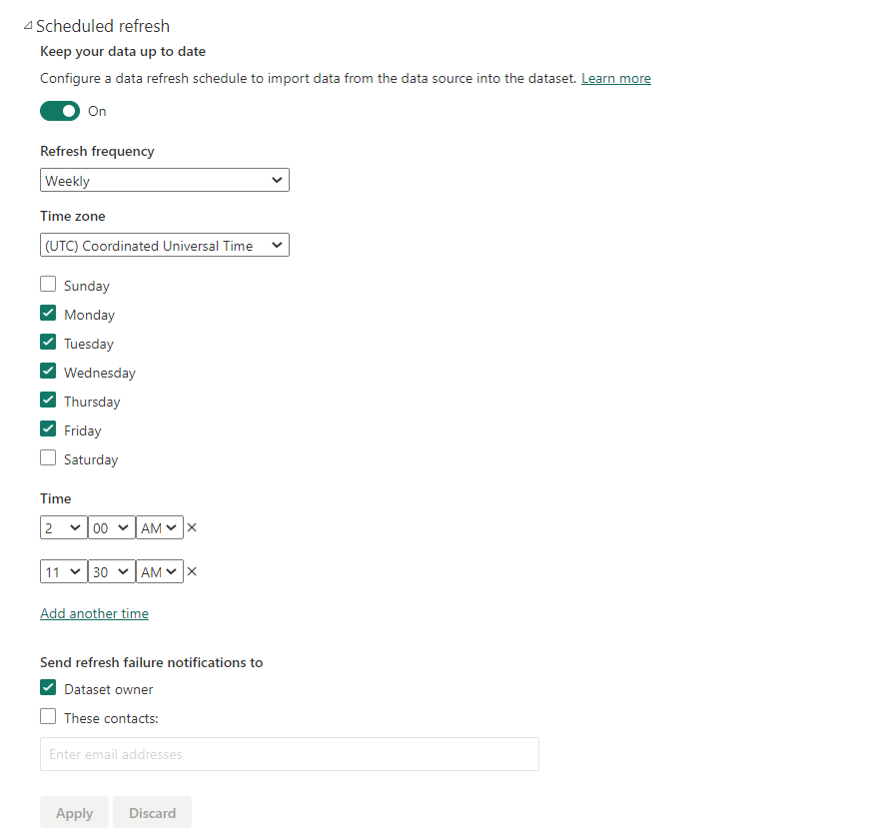
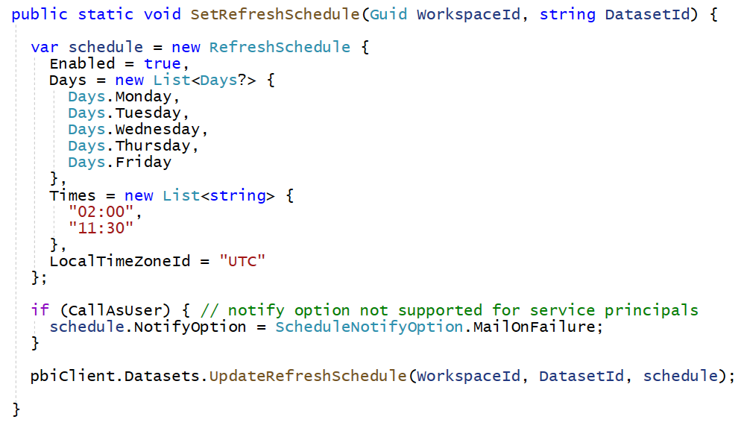
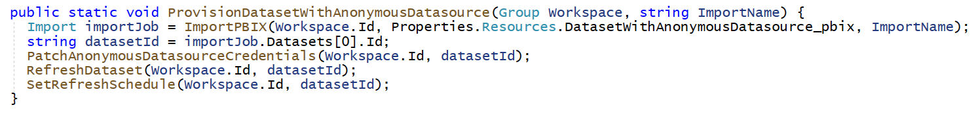
Refreshing Datasets and Setting Refresh Schedules
You can refresh a dataset on demand using code
You can also set a refresh schedule for automatic refreshes
But first, you must patch datasource credentials or the refresh will not work

Slide 25
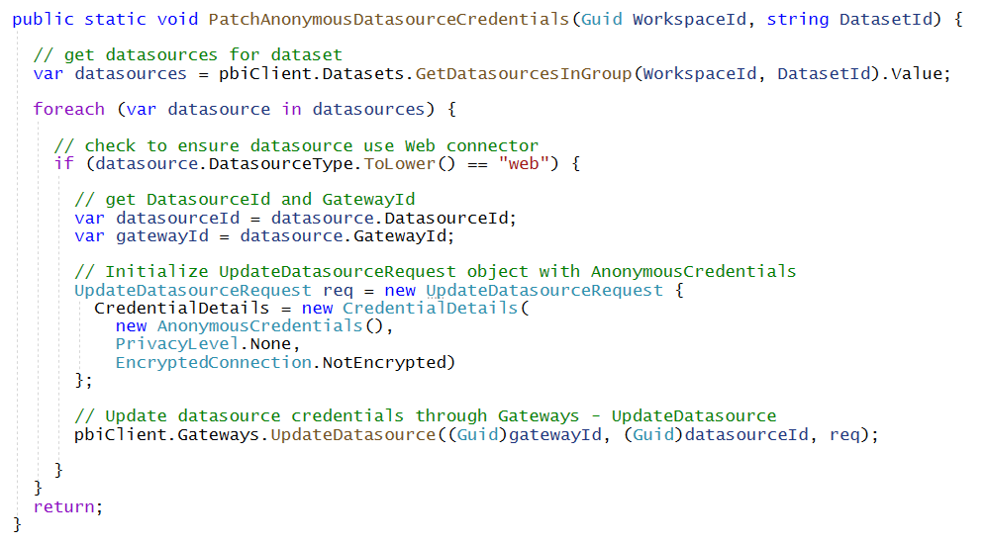
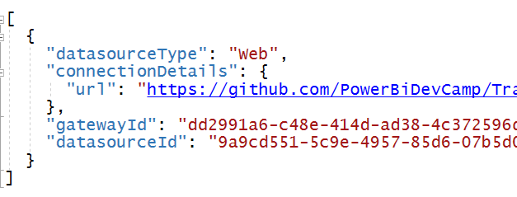
Patching Anonymous Credentials
Steps to patch Web datasource with Anonymous credentials
Call Datasets.GetDatasourcesInGroup to retrieve GatewayId and DatasourceId
Initialize UpdateDatasourceRequest object with AnonymousCredentials object
Set Privacylevel to None, Organization, Private or Public
Set encryption type to NotEncrypted
Call Gateways.UpdateDatasource to execute credential patch operation

Slide 26

Power BI REST API Programmer Epiphany
All datasources have GatewayId whether using On-Prem Gateway or not
Power BI provides virtual gateway for datasources not using On-Prem gateway
Patching credentials in virtual gateway always uses Gateways.UpdateDatesource

Slide 27
Agenda
AuthN and AuthZ with the Power BI REST API
Provisioning Workspaces and Datasets
Patching SQL Datasources using Basic Credentials
Patching ADLS Datasources using Key Credentials
Patching SharePoint and Kusto Datasources using OAuth2 Credentials
Managing Datasources and Credentials with On-Prem Gateways

Slide 28
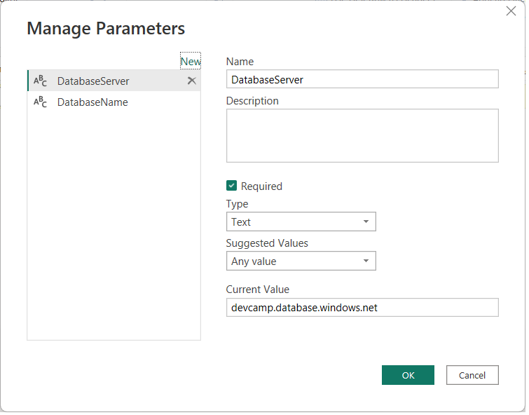
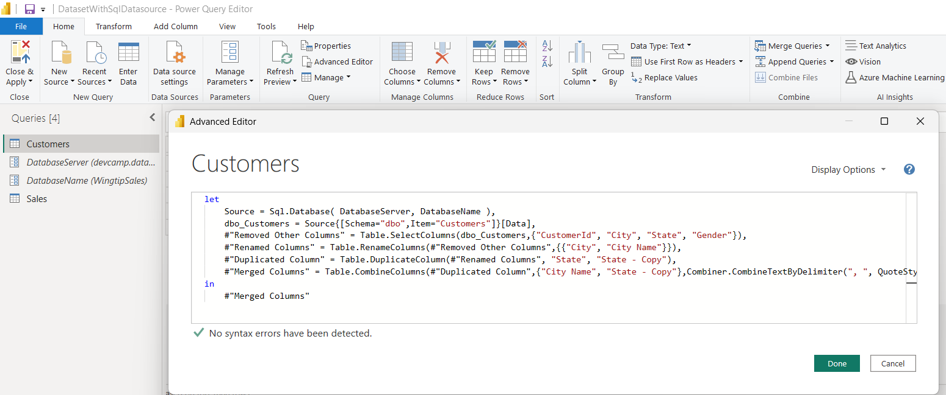
Designing with Dataset Parameters
Dataset parameters provide flexibility when provisioning datasets
PBIX file can be designed as parameterized dataset template
You can create dataset parameters for DatabaseServer and DatabaseName
Then you can update all query M code to use parameters instead of hard-coded values

Slide 29
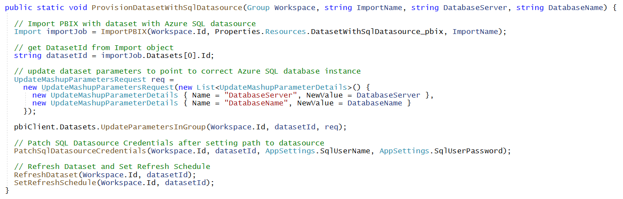
Updating Dataset Parameters During Provisioning
Steps to updating dataset parameter values
Create UpdateMashupParametersRequest object with names and update values
Call Datasets.UpdateParametersInGroup to perform update operation
GOTCHA: If update to parameters changes datasource location, you must repatch credentials

Slide 30
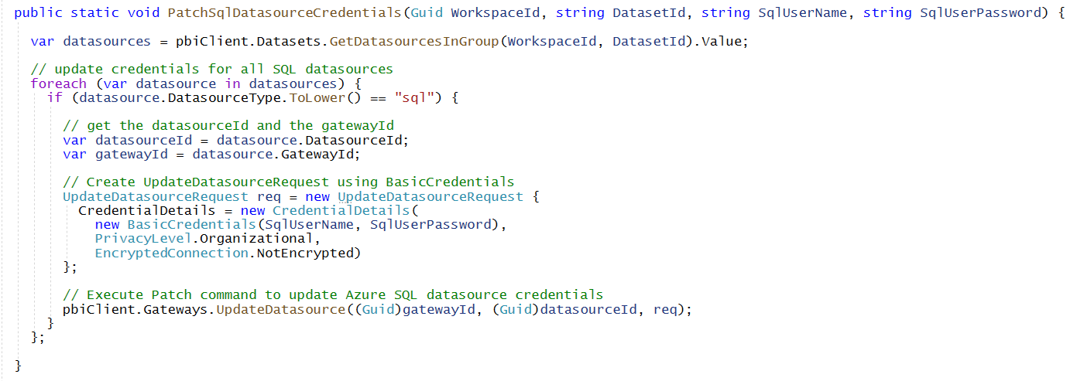
Patching SQL Datasource with Basic Credentials
Steps to patch SQL datasource with Basic credentials
Call Datasets.GetDatasourcesInGroup to retrieve GatewayId and DatasourceId
Initialize UpdateDatasourceRequest object with BasicCredentials object
Set Privacylevel to None, Organization, Private or Public
Set encryption type to NotEncrypted
Call Gateways.UpdateDatasource to complete credential patch operation

Slide 31
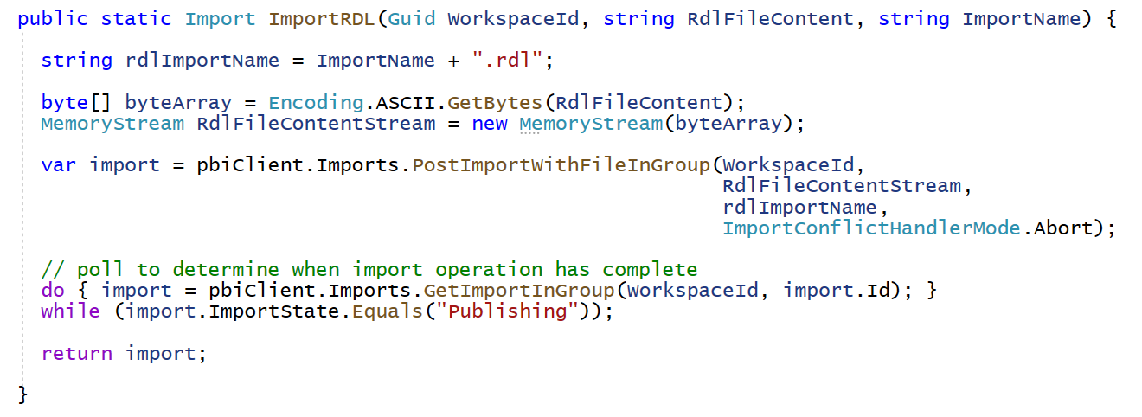
Importing Paginated Reports
Paginated report published by passing RDL file to Imports API
Imports.PostImportWithFileInGroup provides special support for importing RDL files
Import name must end with .rdl file extension
Use conflict handler of Abort – it sounds weird, but it’s required to import RDL files

Slide 32
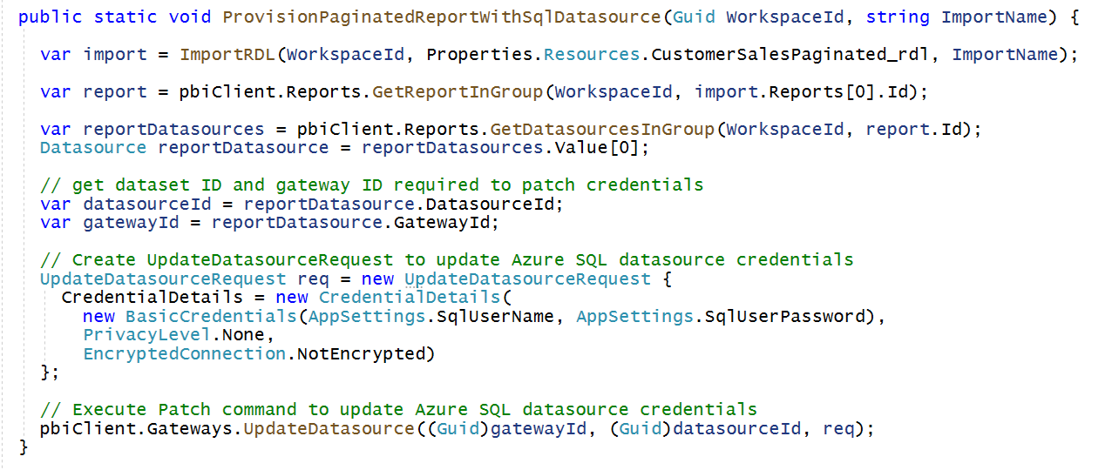
Setting Datasource Credentials for Paginated Reports
Steps to patch SQL datasource behind paginated report
Call Reports.GetDatasourcesInGroup to retrieve GatewayId and DatasourceId
Initialize UpdateDatasourceRequest object with BasicCredentials object
Set Privacylevel to None, Organization, Private or Public
Set encryption type to NotEncrypted
Call Gateways.UpdateDatasource to complete credential patch operation

Slide 33
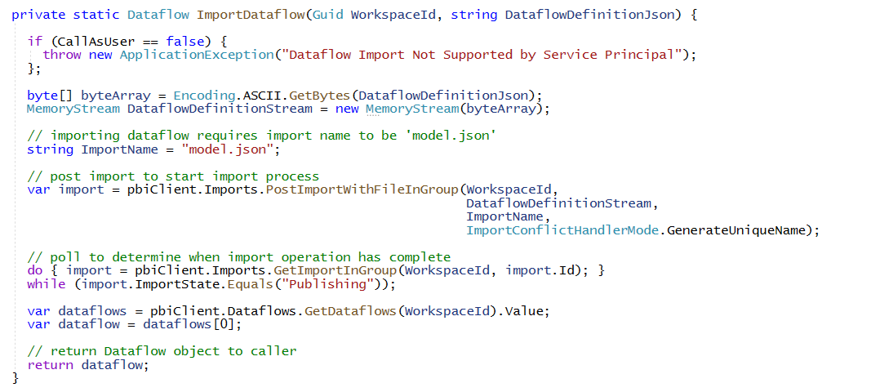
Importing Dataflow
Dataflow published by passing JSON file with dataflow definition to Imports API
Imports.PostImportWithFileInGroup provides special support for importing dataflow
Import name must be set to model.json
Name of workflow determined by what is inside JSON file with dataflow definition
Use conflict handler of GenerateUniqueName – not all that intuitive
GOTCHA: Dataflow Import not supported for service principal

Slide 34
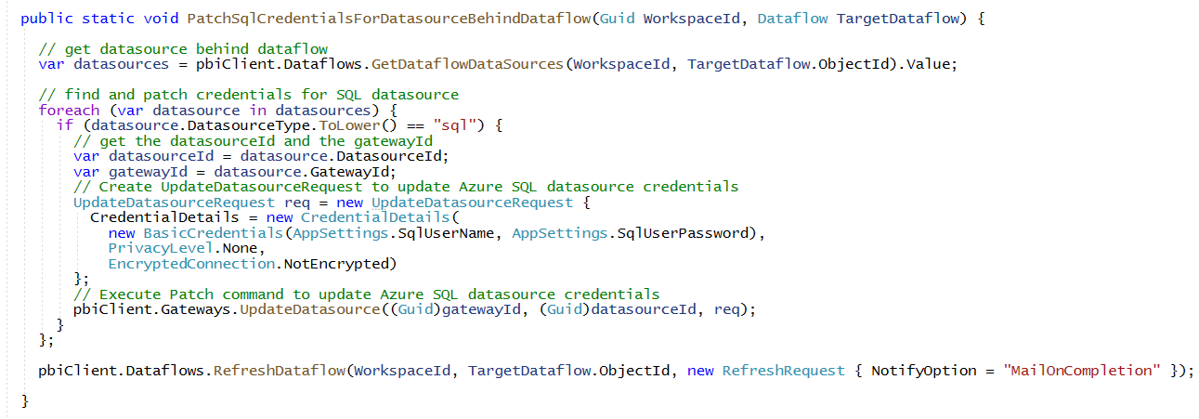
Setting Credentials for SQL Datasource Behind Dataflow
Steps to patch SQL datasource behind dataflow
Call Dataflows.GetDataflowDatasourcesInGroup to retrieve GatewayId and DatasourceId
Initialize UpdateDatasourceRequest object with BasicCredentials object
Set Privacylevel to None, Organization, Private or Public
Set encryption type to NotEncrypted
Call Gateways.UpdateDatasource to complete credential patch operation

Slide 35
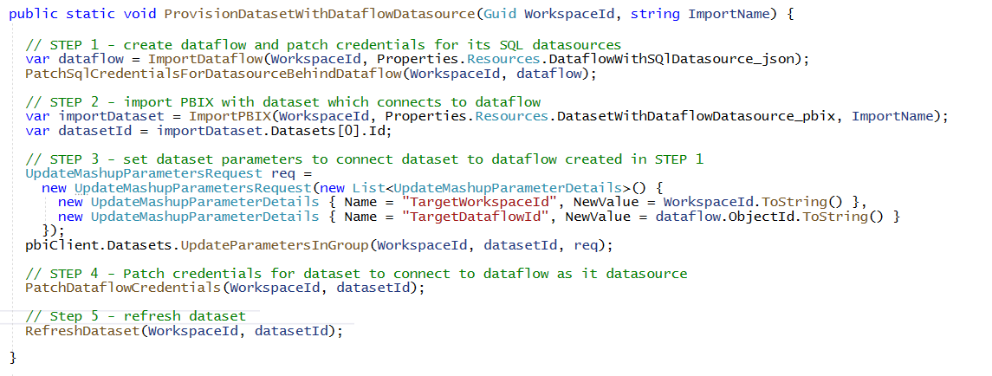
Provision Content with Dataset Connected to Dataflow
STEP 1 - Create dataflow and patch credentials for its SQL datasources
STEP 2 - Import PBIX with dataset which connects to dataflow
STEP 3 - Set dataset parameters to connect dataset to dataflow created in STEP 1
STEP 4 - Patch credentials for dataset to access dataflow by calling PatchDataflowCredentials
STEP 5 - Refresh dataset

Slide 36
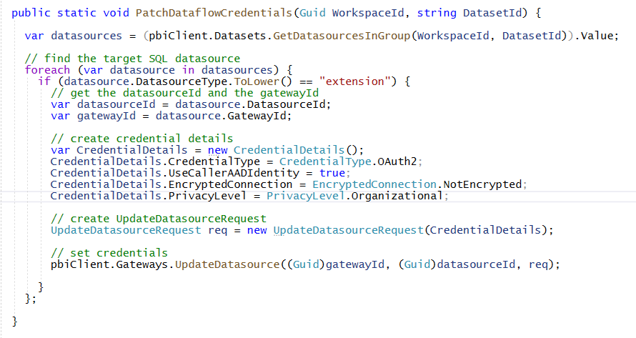
Setting Credentials for Dataset Connection To Dataflow
The trick here is to set CredentialDetails.UseCallerAADIdentity to true

Slide 37
Agenda
AuthN and AuthZ with the Power BI REST API
Provisioning Workspaces and Datasets
Patching SQL Datasources using Basic Credentials
Patching ADLS Datasources using Key Credentials
Patching SharePoint and Kusto Datasources using OAuth2 Credentials
Managing Datasources and Credentials with On-Prem Gateways

Slide 38
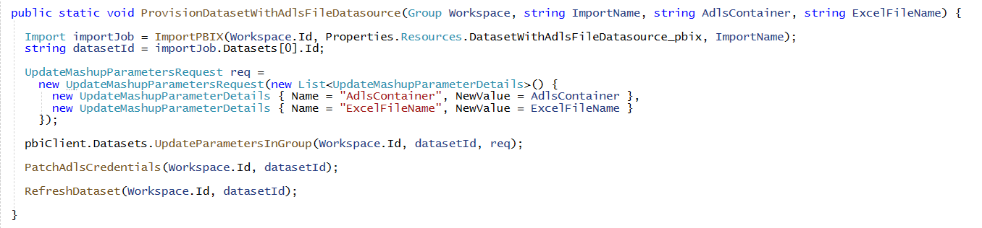
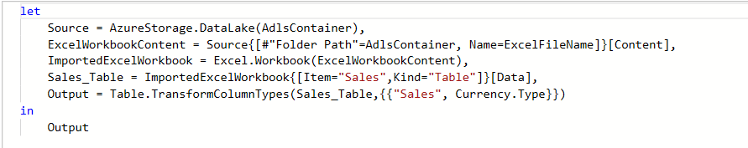
Provisioning Content with ALDS Datasource
Demo involves template dataset PBIX with dataset parameters
Allows configuration of ADLS container and file name after import
PBIX contains M code in queries that use dataset parameters values

Slide 39
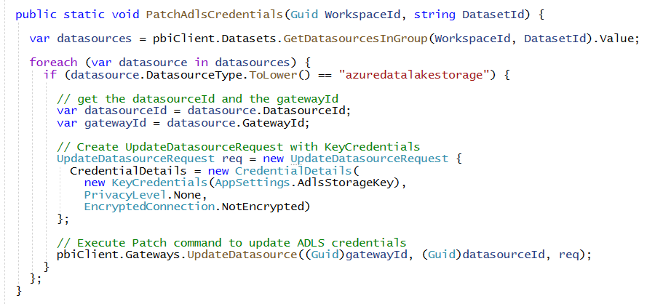
Patching Key Credentials for ADLS Datasources
Patching ADLS Datasource with Key Credentials
Create KeyCredentials object initialized with key value
Key credential authentication often best choice for other datasource types as well
Examples include DataBricks and Snowflake

Slide 40
Each Power BI Dataset Has Exactly One Owner
Deep
Thoughts
Each dataset is owned by a single security principal
Updating parameters and patching datasource credentials only allowed by dataset owner
Dataset owner can be user, service principle or service principal profile
Azure AD group cannot be a dataset owner
Dataset creator is automatically configured as the dataset owner
Dataset ownership can be transferred using a TakeOver operation
Why does a dataset require a single owner?
Single owner constraint enforced for security reasons
Power BI does not support sharing credentials or connections in virtual gateway
Only the owner can modify dataset properties and set datasource credentials
Allowing others to update dataset and reuse credentials would create attack surface
Whoever last updates the dataset must be the one to set credentials

Slide 41
Agenda
AuthN and AuthZ with the Power BI REST API
Provisioning Workspaces and Datasets
Patching SQL Datasources using Basic Credentials
Patching ADLS Datasources using Key Credentials
Patching SharePoint and Kusto Datasources using OAuth2 Credentials
Managing Datasources and Credentials with On-Prem Gateways

Slide 42
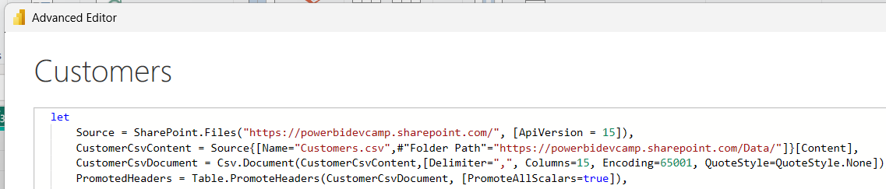
Setting OAuth2 Credentials for SharePoint Datasources
You must access SharePoint files in Power Query in using SharePoint connector
Web connector datasources do not support setting OAuth2 credentials through API
Setting OAuth2 credentials requires acquiring access token to SharePoint resources
Setting OAuth2 credentials only supports setting access token – but not refresh tokens
Once set, OAuth2 credentials will usually only last for 60 minutes
Power BI REST API does not support passing refresh token along with access token

Slide 43
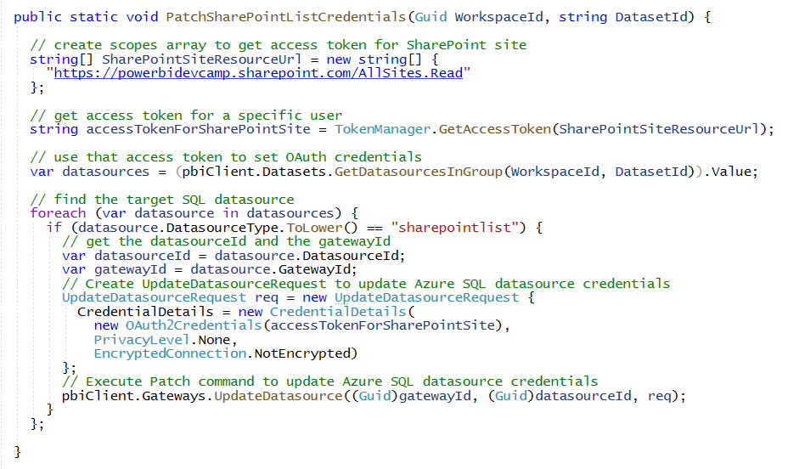
Patch SharePoint Datasources using OAuth2 Credentials
Steps to patch OAuth2 credentials for SharePoint file in document library
Determine delegated permission scope required to access SharePoint site
Call to Azure AD to acquire access token with delegated permissions for SharePoint site
Initialize OAuth2Credential with access token for SharePoint site
Call Gateways.UpdateDatasource as usual

Slide 44
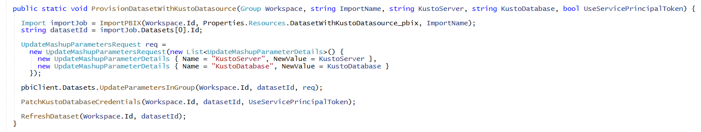
Setting OAuth2 Credentials for Kusto Datasources
Demo shows connecting to Kusto datasource using OAuth2 credentials
It demonstrates setting OAuth2 credentials using user token and using service principal token
Demo uses dataset parameters to configure KustoServer and KustoDatabase name
Power Query M code references dataset parameters to connector to Kusto database

Slide 45
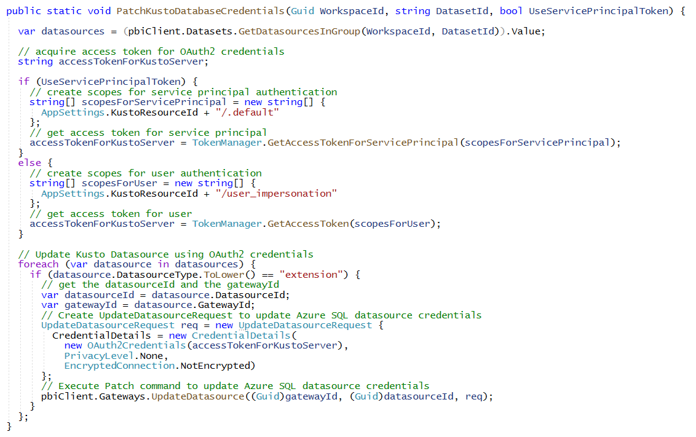
Generating Access Tokens for Kusto Datasources
Observe difference between generating access token for user vs service principal
Delegated permission user: https://kusto.eastus2.kusto.windows.net/user_impersonation
Resource ID for service principal: https://kusto.eastus2.kusto.windows.net/.default

Slide 46
Observations About Using OAuth2Credentials
Power BI REST API provides no support to patch OAuth2 credentials with refresh tokens
Once set, OAuth2 credentials are always short-lived, usually about 60 minutes
As a user, you can do things in Power BI Service UI that cannot be replicated with code
Setting OAuth2 credentials through UI supports long-lived credentials with refresh tokens
Key Takeaways
Everything works in scenario where you set OAuth2 credentials in code and then start refresh
Patching with OAuth2 credentials causes problems in scenarios with scheduled refresh
Workaround is to create scheduled Azure function to repatch credentials every 45 minutes
Prefer authenticating with Key credentials over OAuth2 credentials to avoid this problem

Slide 47
Agenda
AuthN and AuthZ with the Power BI REST API
Provisioning Workspaces and Datasets
Patching SQL Datasources using Basic Credentials
Patching ADLS Datasources using Key Credentials
Patching SharePoint and Kusto Datasources using OAuth2 Credentials
Managing Datasources and Credentials with On-Prem Gateways

Slide 48
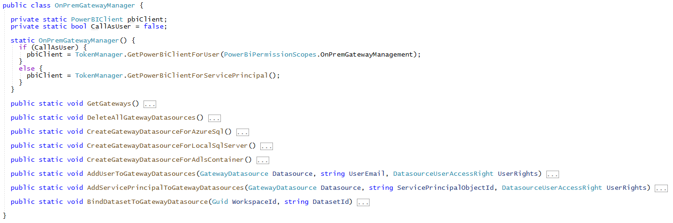
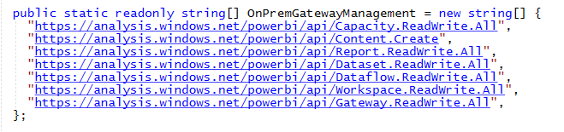
Programming with On-Premises Gateway
Samples of code shown in OnPremGatewayManager class
When calling as user, caller requires delegated permissions of Gateway.ReadWrite.All

Slide 49
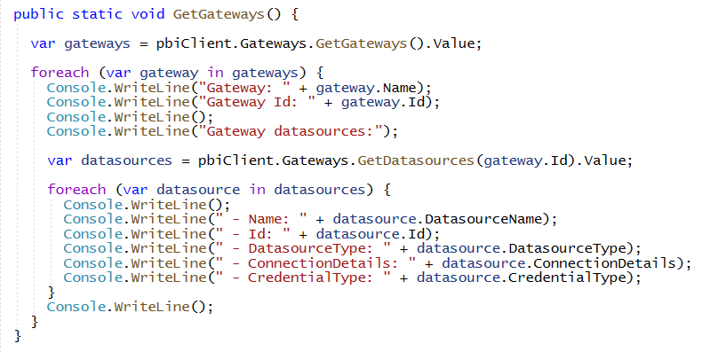
Getting Started with Gateways API
You can enumerate gateways and gateway datasources
Gateways.GetGateways returns all gateways in which caller is a member
Gateways.GetDatasource allows you to enumerate gateway datasource in gateway

Slide 50
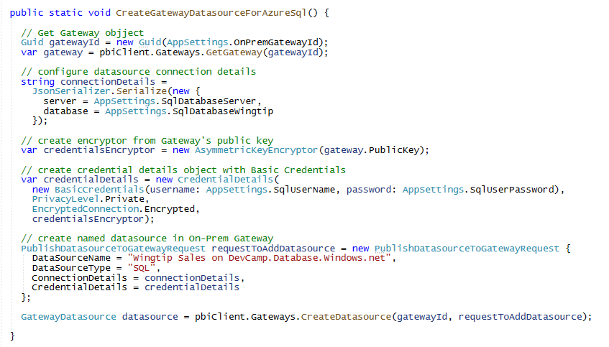
Creating Gateway Datasource for Azure SQL
Steps to creating new Gateway Datasource
You need to configure ConnectionDetails
You need to encrypt credentials using public key of Gateway
You need to create PublishDatasourceToGatewayRequest object
Create gateway datasource by calling Gateways.CreateDatasource

Slide 51
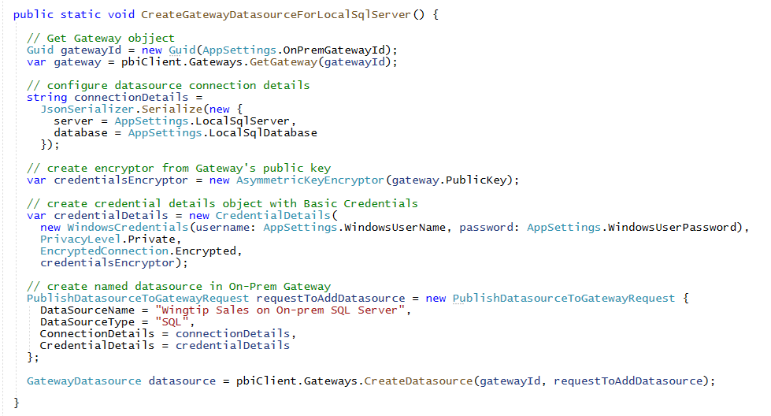
Creating Gateway Datasource for On-Prem SQL Database
On-Prem Gateway often used to connect to on-premises datasources
Credentials added using WindowsCredentials to authenticate in local network

Slide 52
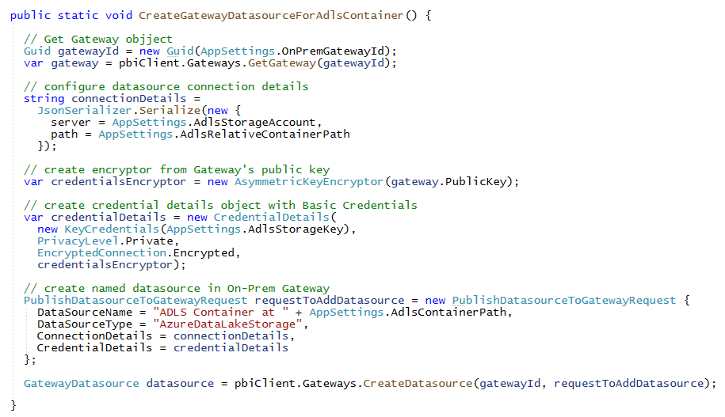
Creating Gateway Datasource for ADLS Container
On-Prem Gateway can also be used to connect to cloud datasources
Provides flexible way to share pre-configured connections with dataset builders
Inserting On-Prem Gateway in optional scenarios provides better control and monitoring

Slide 53
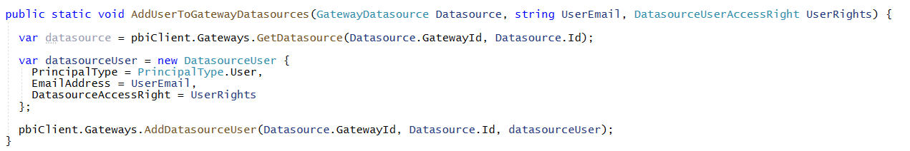

Configuring Permissions for Gateway and Datasource
You must configure Gateway permissions for user and service principal
Caller must be added as gateway member before it can create gateway datasources
Caller must be added a datasource member to bind to dataset to datasource
Code required to add a user as a gateway datasource member
Code required to add a service principal as a datasource member

Slide 54

Binding Dataset to Gateway Datasource
Permission requirements for binding dataset to gateway datasource
Caller must be member of gateway datasource
Caller must be dataset owner
Steps to bind dataset to gateway datasource
Create BindToGatewayRequest object with GatewayID
You can optionally add target DatasourceID to BindToGatewayRequest object
Execute TakeOverInGroup if caller is not already the dataset owner
Call Datasets.BindToGatewayInGroup to perform binding operation

Slide 55
Summary
AuthN and AuthZ with the Power BI REST API
Provisioning Workspaces and Datasets
Patching SQL Datasources using Basic Credentials
Patching ADLS Datasources using Key Credentials
Patching SharePoint and Kusto Datasources using OAuth2 Credentials
Managing Datasources and Credentials with On-Prem Gateways

Slide 56
Microsoft Power BI
Questions?

